Slide 1



Introduction to Arduino and C Programming

Slide 2

About me
Born in Cincinnati and Raised in Florence
2nd year Computer Science Student, minoring in Math
I am currently on Co-op at 84.51 as a software engineer, which is I want to do in the future!
Current Leadership Positions:
Vice President of UC CubeCats
ACM-W Volunteering Chair
Darwin T. Turner Ambassador
Nathan Nguyen

Slide 3
Assumptions and Goals
Assumptions
You have taken at least or currently taking one programming course
Goal
Be able to create applications on arduino using the following methods
Adding Shields (Accessories; Attachments)
Adding Libraries
Using control flows (If-Else, Do While, While loop)
Using functions (Methods: e.g. getVariable, setVariable, changeVariables)
Reading connection diagrams
Debugging applications
Want to follow along?
Go to this github link to download all of the demos I will be showing you today:
https://github.com/Nathann03/Intro_to_Arduino_prog

Slide 4
Agenda
Introduction to the Arduino Hardware
IDE, Variables, Operands, and the Serial Monitor Control Flow
Loops
Arrays & Strings
Functions, Structs, and Unions Libraries/IO/Connection Diagrams/EEPROM
Combining it all together - Somewhat
Shameless Promotion

Slide 5
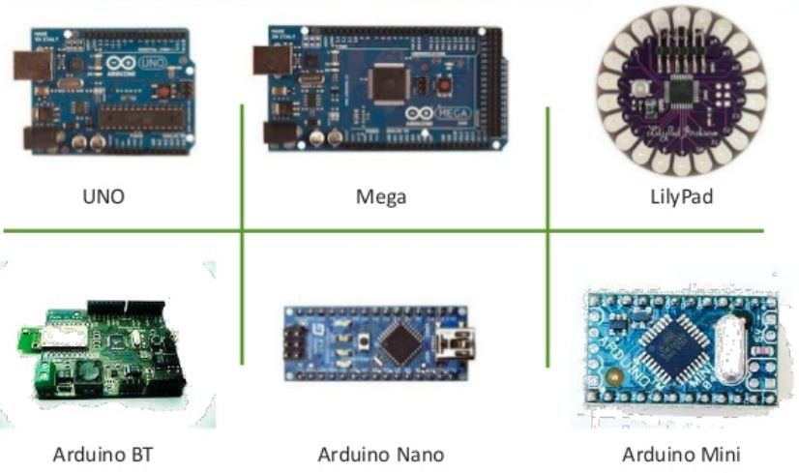
Arduino Models
Arduino’s are microcontrollers: mini-computers with their own memory, disk, and processor

Slide 6
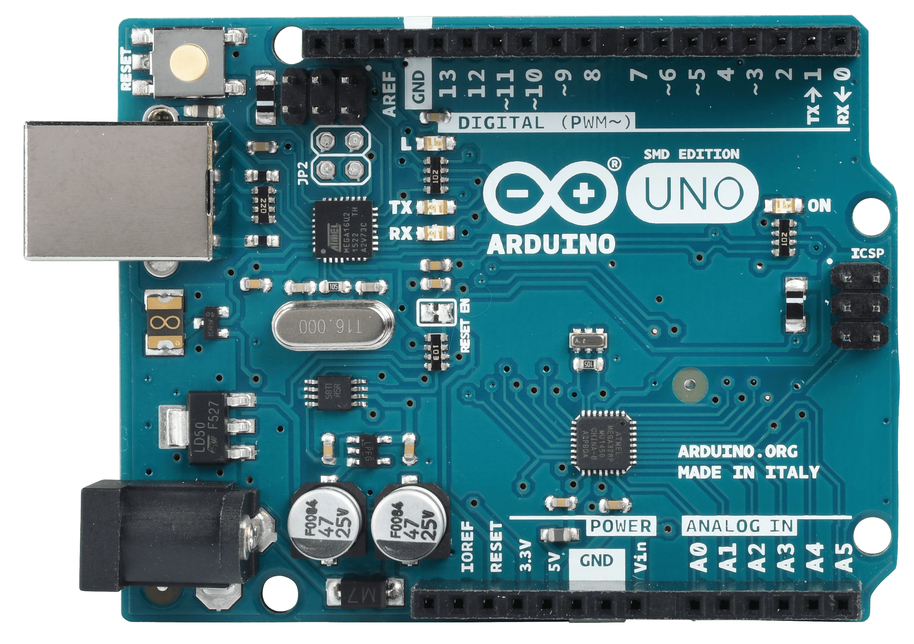


Lights on an Arduino (Arduino UNO)
4 Lights on an Arduino
ON Light - shows that it is powered on
TX Light - shows that data is being transmitted
RX Light - shows that data is being received
L Light - an LED you are able to control in your program
Serial Port (USB)
External Power Source (AA, AAA Batteries)

Slide 7
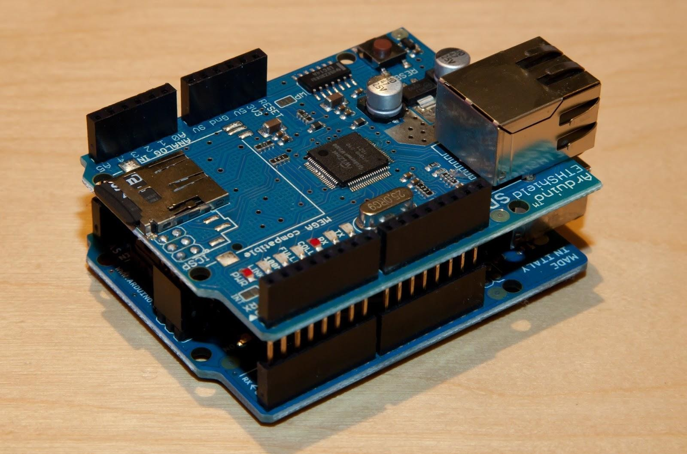

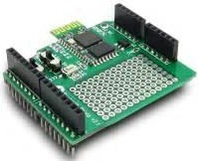

Arduino Accessories & Shields
Accessories include USB A-B cable, external power source, breadboard, resistors, variable resistors (potentiometers), switches, wires, sensors, motors
Shields” are add ons or accessories that extend the functionality of Arduino. The code is already written for them
Ethernet Shields
LCD Shields
Motor Shields extends the number of motors you can use on an arduino from 6
Prototype Shield - for circuit development rather than soldering
Use breadboard as an alternative to this shield
There are many more shields including bluetooth, wireless, etc.
attery or AC/DC converter to run without being connected to a computer
● Arduino models allow you to connect a b

Slide 8
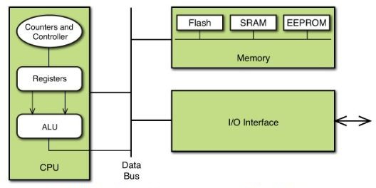
Basic components of the Arduino Microcontroller

Slide 9
Agenda
Introduction to the Arduino Hardware
IDE, Variables, Operands, and the Serial Monitor Control Flow
Loops
Arrays & Strings
Functions, Structs, and Unions Libraries/IO/Connection Diagrams/EEPROM Combining it all together - Somewhat
Shameless Promotion

Slide 10
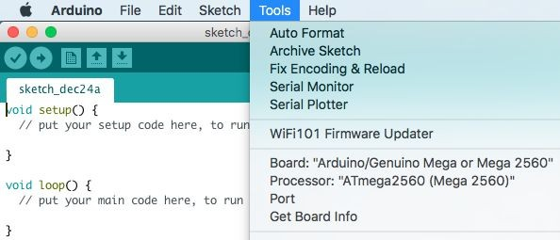
The Arduino IDE
You can retrieve the IDE from the main arduino website (arduino.cc)
The IDE is written in Java; however, the arduino only accepts programs written in C. Therefore you must program in C. The IDE acts as a C Compiler.
Tip:
Use Auto-Format to clean your code spacing
Use Serial Plotter to see Arduino Output
Verify: Checks if your program compiles (syntax check) Upload: Uploads your program to the Arduino.
New: Creates a new program file
Open: Open an existing arduino program file Save: Allows you to save the current program
Must Choose Appropriate Arduino Board before uploading programs & choose the port on the computer the arduino is connected to
9

Slide 11
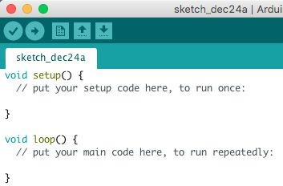
How are Arduino Programs Structured
void setup() { Code to run once
}
Title of
Program
void loop(){
Code to run repeatedly
}
Programs get saved in Documents/Arduino on your workstation
10

Slide 12
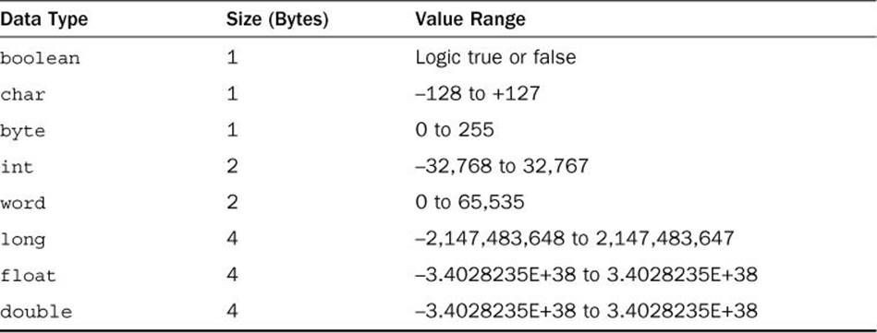
Declaring and Instantiating Variables
Declaring a Variable
dataType variableName;
Example:
int year;
Instantiating a Variable
Add equals sign
Example: int year;
year = 2017;
Declaring and Instantiating Simultaneously
Example:
int year = 2017;
For Constants
Add ‘const’ before dataType Example:
const float pi = 3.14;
11

Slide 13
Scope of Variables
Variable scope determines where the variable can be used in the sketch. There are two variable scopes
Local Variables
Can only be used inside a function, and only appear inside that function block.
You won't see a local variable from the setup function in the loop function
Global Variables (Static Variables)
Can be used in ALL functions
Common to see them at the start of the sketch before the setup function

Slide 14
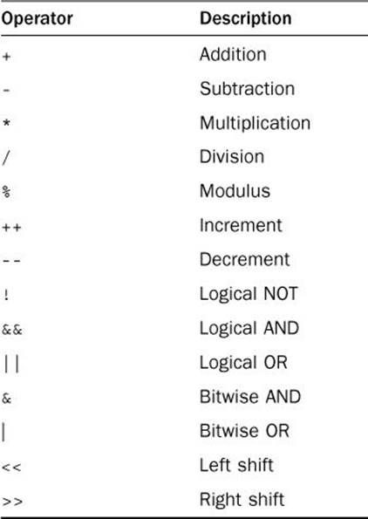
Math Operators
Standard Operators are built-in for use and can be used with variables. Two examples below:
int x; float y; int z;
x = 5;
y = 2.7;
z = x+y;
What is z equal to above?
int x = 5; float y = 2.7; float z = x+y;
What is z equal to above?
Tip: instead of x = x + 1; you can write x += 1;

Slide 15
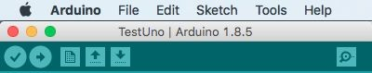
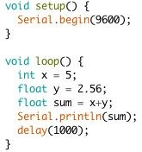
Using the Serial Monitor
The serial monitor allows you to see the output from the program
1. insert Serial.begin(baudRate); to initialize the serial port
Located Here
baudRate = Speed of Connection (higher is faster; must match workstation baud). // i want that baud
default baud rate is 9600;
Printing to the serial monitor:
Serial.print(sum) // does not start a new line Serial.println(sum) //starts a new line
Working with time
delay(x): pauses the sketch for x milliseconds
delayMicroseconds(x): pauses the sketch for x microseconds
micros(): Returns the number of microseconds since the arduino was reset
millis(): returns the number of milliseconds since the Arduino was reset

Slide 16
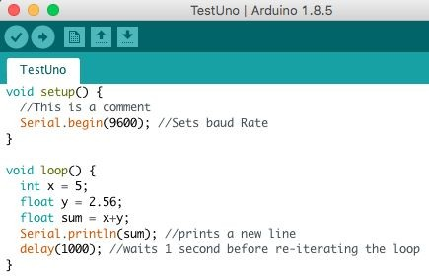
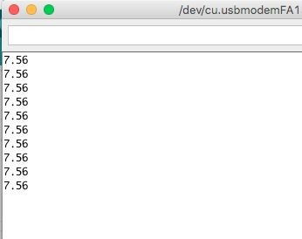
Output on the Serial Monitor
Note: You cannot concatenate the Serial output Ex.
// this won’t work Serial.println(“The sum is” + sum);
Tip: use // to place a comment. Examples above
15

Slide 17
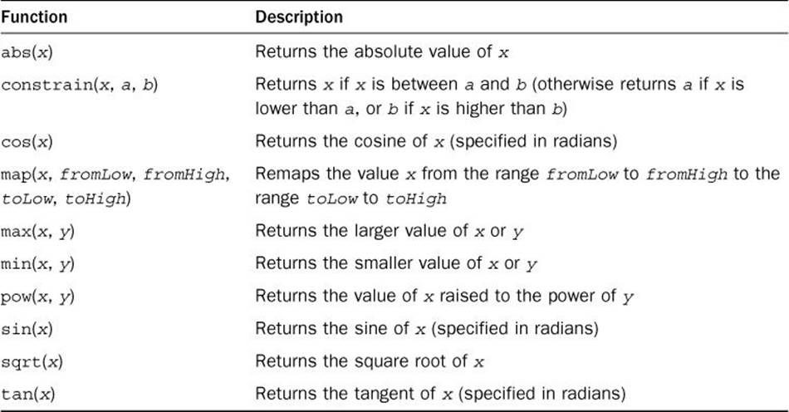
Advanced Math Functions
Example
int Temperature = -7;
int value = abs(temperature); Serial.println(value);
What does it print above?
Note: The map() and contrain() functions are mostly used with sensors. They allow you to keep values returned by the sensors within a specific range that your sketch can manage

Slide 18
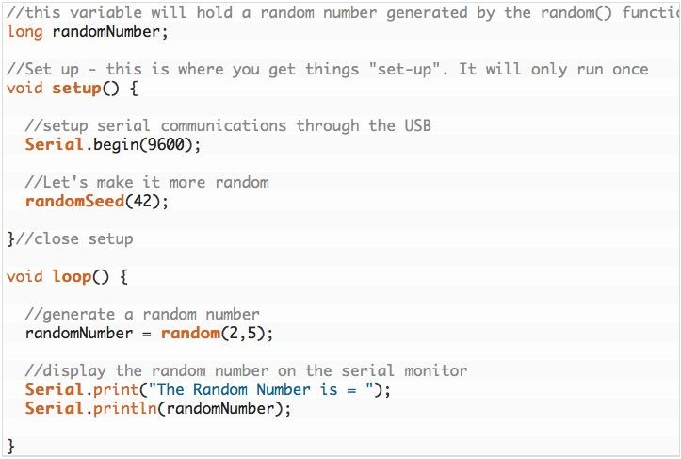
Generating Random Numbers
Two functions are available for working with random numbers. random() and randomSeed()
random(min, max) : returns a random number between min and max -1 random(max) : returns a random number between 0 and max -1
randomSeed(seed): Initializes the random number generator, causing it to restart at an arbitrary point in random sequence.

Slide 19
Agenda
Introduction to the Arduino Hardware
IDE, Variables, Operands, and the Serial Monitor Control Flow
Loops
Arrays & Strings
Functions, Structs, and Unions Libraries/IO/Connection Diagrams/EEPROM Combining it all together - Somewhat
Shameless Promotion

Slide 20
if control
if/else control
if (condition) {
Statement 1;
Statement 2; etc.
}
else { Statements;
}
Example if (grade > 92) {
myGrade = ‘A’;
} else {
myGrade = ‘F’;
}
if/else if control
if (condition)
Statement; else if (condition)
Statement; else if (condition)
Statement;
else
Statement;
Example if (grade > 92) {
myGrade = ‘A’;
else if (grade > 83) myGrade = ‘B’;
else
myGrade = ‘C’;
if (condition) {
Statement 1;
Statement 2; etc.
}
Example
if (temperature > 100) { Serial.println(“wow”!) Serial.println(“that’s hot!”)
}
19

Slide 21
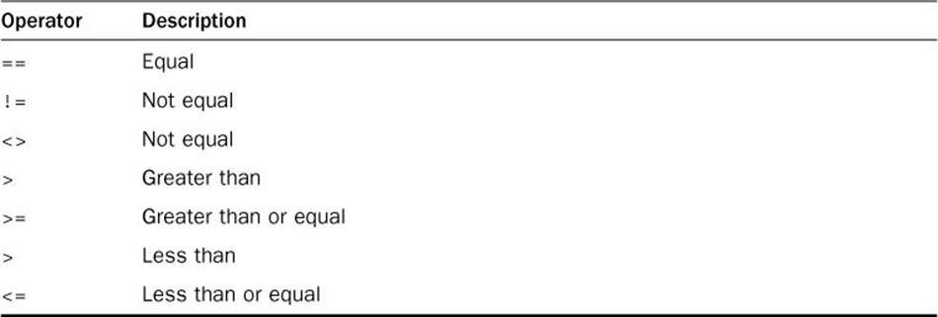
Numeric Comparisons
Negating a condition check
int a == 1; If (!(a == 1))
Serial.println(“The ‘a’ variable is not equal to 1”);
if(!(a ==2))
Serial.println(“The ‘a’ variable is not equal to 2”);
Compound Conditions
Example 1
If ((a == 1) || (b == 1)){
statements;
}
Example 2
If ((a == 1) && (b == 2)) {
statements;
}
Or just use
!= in the condition
20

Slide 22
Using a switch statement
Instead of doing a lot of if and else statement, it may be useful to do a switch
Format
switch (var) {
case 23:
//do something when var equals 23 break;
case 64:
//do something when var equals 64 break;
default:
// if nothing else matches, do the default
// default is optional break;
}
Example
switch (grade) { case ‘A’:
Serial.println(“you got higher than a 92”); break;
case ‘B’:
Serial.println(“You got higher than a 80”); break;
default:
Serial.println(“You have dishonored the family”); break;
}

Slide 23
Agenda
Introduction to the Arduino Hardware
IDE, Variables, Operands, and the Serial Monitor Control Flow
Loops
Arrays & Strings
Functions, Structs, and Unions Libraries/IO/Connection Diagrams/EEPROM Combining it all together - Somewhat
Shameless Promotion

Slide 24
while
for
for (statement1; condition; statement 2){ Code statements
}
do while
while (condition){
Code statements
}
do {
Code statements
} while (condition);
executes at least once, and until condition is met
executes until condition is met
executes until condition is met
Example
int values[5] = {10, 20, 30, 40, 50};
for (int counter = 0; counter < 5; counter ++){ Serial.print(“one value in the array is “ ); Serial.println(values[counter]);
}
Example
int i = 0;
while (i<3) {//hearts for days Serial.println(“ i is : “ i);
i++;
}
Example
int i = 0; Serial.println(“Hi”); do {
Serial.println(“my name is”); if(i==0) Serial.println(“What”); if(i==1) Serial.println(“Who”); i++;
} while (i < 2);
Serial.println(“slicka chika slim shady”); ²³

Slide 25
Loops Continued
Using Multiple Variables
Nesting Loops
You can initialize multiples variables in a for statement
You can place loops inside of another loop. The trick to using inner loop sis that you must complete the inner loop before you complete the outer loop.
Example
Example
int a,b;
For (a = 0, b = 0; a < 10; a++, b++){
Serial.print(“One value is “); Serial.println(a);
Serial.print(“ and the other value is “); Serial.println(b);
}
int a,b;
for (a = 0; a < 10; a++){
for (b = 0; b < 10; b++){ Serial.print(“one value is “); Serial.print(a);
Serial.print(“and the other value is “); Serial.println(b);
}
}

Slide 26
Controlling Loops
Break Statement
Continue Statement
You can use the break statement when you need to break out of a loop before the condition would normally stop the loop
You can use the continue statement to control loops. Instead of telling the Arduino to jump out of a loop, it tells the Arduino to stop processing code inside the loop, but still jumps back to the start of the loop
Example
Example:
int i;
for (i = 0; i <= 10; i++){
If ((i > 5) && (i < 10))
Continue;
int i;
for (i = 0; i <= 20; i++) { if (i == 15) Break;
Serial.print(“currently on iteration:”); Serial.println(i);
}
Serial.println(“This is the end of the test”);
}
Serial.print(“The value of the counter at“); Serial.println(i);
}
Serial.println(“this is the end of the test”);

Slide 27
Agenda
Introduction to the Arduino Hardware
IDE, Variables, Operands, and the Serial Monitor Control Flow
Loops
Arrays & Strings
Functions, Structs, and Unions Libraries/IO/Connection Diagrams/EEPROM Combining it all together - Somewhat
Shameless Promotion

Slide 28
Arrays
An array stores multiple data values of the same data type in a block of memory, allowing you to reference the variables using the same variable name. It does it through an index value.
Format
datatype variableName[size];
Using Loops with Arrays
Example 1:
int myarray[10]; //able to store 10 values myarray[0] = 20; //stores values in index 0 myarray[1] = 30; // stores values in index 1
int values[5] = {10, 20, 30, 40, 50};
for (int counter = 0; counter < 5; counter ++){ Serial.print(“one value in the array is “ ); Serial.print(values[counter]);
}
Example 2:
// assigns values to first 5 data locations (index 0-4) Int myarray[10] = {20, 30, 40, 50, 100};
Example 3
int myarray[ ] = {20, 30, 40, 50 100};

Slide 29
Arrays Continued
Determining the size of an Array
You may not remember how many data points are in your array
You can use the handy sizeof function
Challenge Question 1: What is the array ‘myArray’ look like in the program below?
int myArray[3][4];
for (int i = 0; counter < 3; i ++){ for (int j = 0; j < 4; i++) { myArray[ i ] [ j ] = 1;
}
}
Challenge Question 2: What is syntactically wrong with the array below? How do i fix it?
char myArray[ ] = { “mon”, “tue”, “wed”, “thu”, “fri”};
size = sizeof(myArray) / sizeof(int);
Example:
for (counter =0; counter < (sizeof(value)/sizeof(int)); counter++){
//This will only iterate through number of points in an array statements;
}

Slide 30
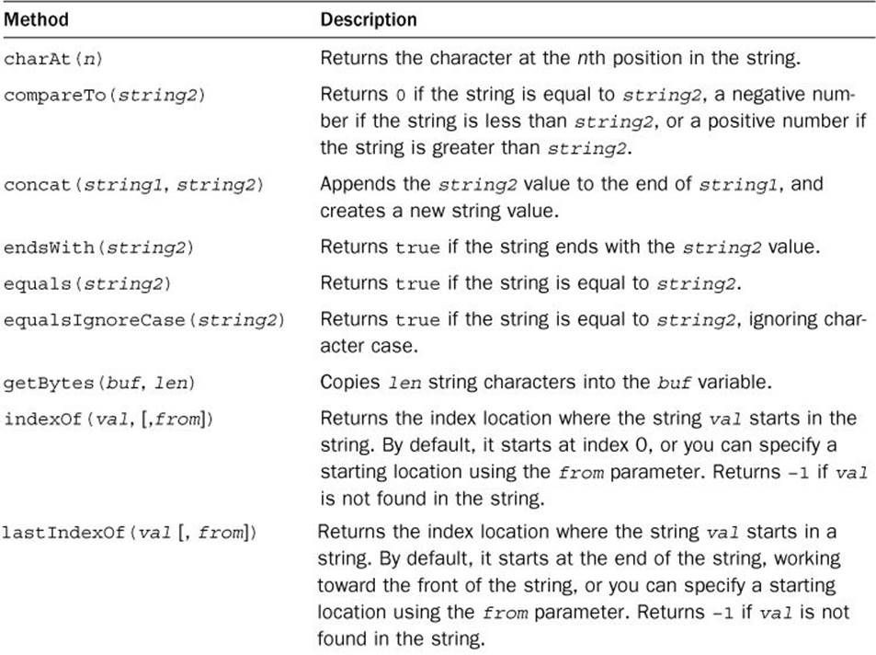
Strings
A string value is a series of characters put together to create a word or sentence
Format
String name = “my text here”;
Example
String myName = “Jackie Chan”;
Manipulating Strings
String myName = “Jackie Chan”; myName.toUpperCase();
Output: JACKIE CHAN
29

Slide 31
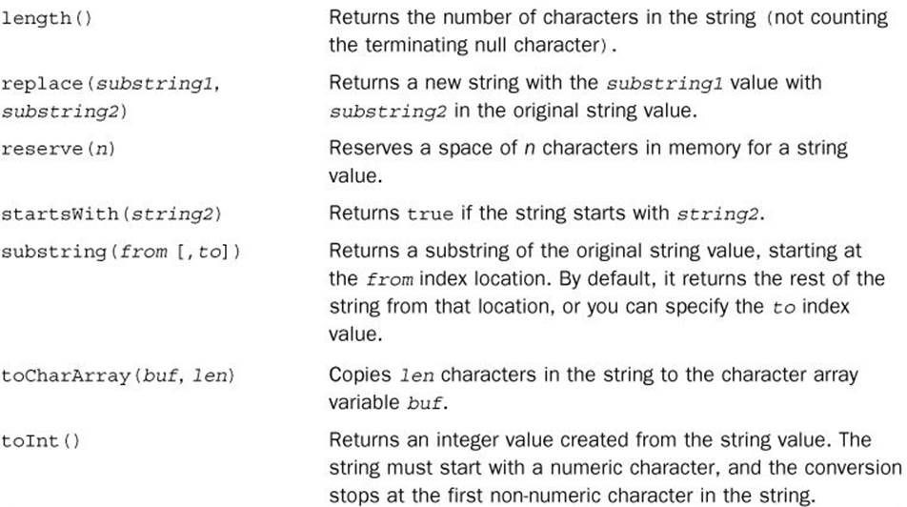
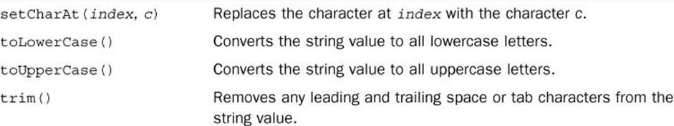
More String Functions
Although you can just create a char array, Strings are much easier to work with! They have many more supported functions

Slide 32
Agenda
Introduction to the Arduino Hardware
IDE, Variables, Operands, and the Serial Monitor Control Flow
Loops
Arrays & Strings
Functions, Structs, and Unions Libraries/IO/Connection Diagrams/EEPROM Combining it all together - Somewhat
Shameless Promotion

Slide 33
Functions
You’ll often find yourself using the same code in multiple locations. Doing large chunks of these is a hassle. However, functions make these a lot easier. You can encapsulate your C code into a function and then use it as many times as you want.
Structure
TIP: Make sure you define your function outside of the setup and loop functions in your arduino code sketch. If you define a function inside another function, the inner function becomes a local function, and you can't use it outside the outer function
datatype functionName() {
// code statements
}
To create a function that does not return any data values to the calling program, you use the void data type for the function definition
Void myFunction() {
Serial.println(“This is my first function”);
}

Slide 34
Using the function/Returning a value
Returning a Value
To return a value from the function back to the main program, you end the function with a return statement
Using the Function
To use a function you defined in your sketch, just reference it by the function name you assigned, followed by parentheses
void setup() {
Serial.begin(9600) MyFunction();
Serial.println(“Now we’re back to the main program”);
}
return value;
The value can either a constant numeric or string value, or a variable that contains a numeric or string value. However, in either case, the data type of the returned value must match the data type that you use to define the function
int myFunction2() { int value = 10*20; return (value);
}
33

Slide 35
Passing Values to Functions
You will most likely want to pass values into function. In the main program code, you specify the values passed to a function in what are called arguments, specific inside the function parenthesis
returnValue = area(10,20);
The 10 and 20 are value arguments separated by a comma. To retrieve the arguments passed to a function, the function definition must declare what are called parameters. You do that in the main function declaration line
void setup() {
Int returnValue; Serial.begin(9600);
Serial.print(“The area of a 10 x 20 size room is “);
returnValue = area(10,20); Serial.println(returnValue);
}
Arguments
void loop() {
}
Parameters
int area (int width, int height) { int result = width * height; Return result;
34
}

Slide 36
Handling Variables inside Functions
One thing that causes problem for beginning sketch writers is the scope of a variable. He scope is where the variable can be referenced within the sketch. Variables defined in function can have a different scope than regular variables. That is, they can be hidden from the rest of the sketch. Functions use two types of variables:
Global Variables Local Variables
Defining Global Variables
Write them before the setup() loop. Ex: const float pi = 3.14;
Be careful in modifying global variables.
Declaring local variables
Local variables are declared in the function code itself, separate from the rest of the sketch code. What’s interesting is that a local variable can override a global variable (but not good practice)
35

Slide 37
Calling Functions Recursively
Recursion is when the function calls itself to reach an answer. Usually a recursion function has a base value that it eventually iterates down to. Many advanced algorithms use recursion to reduce a complex equation down one level repeatedly until they get to the level defined by the base value.
int factorial (int x) {
if (x <=1) return 1;
else return x * factorial(x-1);
}
Remember you are allowed to call other functions from inside a function
36

Slide 38
Structs
Data structures allow us to define custom data types that group related data elements together into a single object.
Full Example: Declaring and Calling
struct sensorinfo {
char date[9]; int indoortemp;
int outdoortemp;
}morningTemps
Before you can use a data structure in your sketch, you need to define it. To define a data structure in the Arduino, you can use the struct statement. Here is the generic format for declaration
Format
struct name {
variable list
};
void setup() {
// put your setup code here, to run once: Serial.begin(9600); strcpy(morningTemps.date, "01/01/14"); morningTemps.indoortemp = 72;
morningTemps.outdoortemp = 25; Serial.print ("Today's date is "); Serial.println(morningTemps.date); Serial.print("The morning outdoor temperate is "); Serial.println(morningTemps.outdoortemp);
Example of declaration
struct sensorinfo {
char date[9]; int indoortemp;
int outdoortemp;
}morningTemps, noonTemps, eveningTemps;
}
37

Slide 39
Unions
Unions allow you to have a variable take on different data types
//Full Example:
Union{
float analogInput; Int digitalInput;
}sensorInput;
Format
union {
//variable list
};
//Saving a value
Example
Union {
float analogInput; int digitalInput;
} sensorInput;
sensorInput.analogInput = myFunction1(); sensorInput.digitalInput = myFunction2();
//Calling a value; Serial.println(sensorInput.analogInput); Serial.println(sensorInput.DigitalInput);
38

Slide 40
Agenda
Introduction to the Arduino Hardware
IDE, Variables, Operands, and the Serial Monitor Control Flow
Loops
Arrays & Strings
Functions, Structs, and Unions Libraries/IO/Connection Diagrams/EEPROM Combining it all together - Somewhat
Shameless Promotion

Slide 41
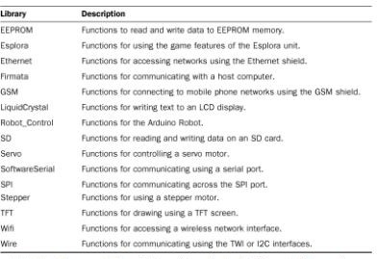
Using Libraries
Libraries allow you to bundle related functions into a single file that the Arduino IDE can compile into your sketches. Instead of having to rewrite the functions in your code, you just reference the library file from your code, and all the library functions become available. This is handy for Arduino Shields
Defining the library in your sketch
#include ‘libraryheader’ #include ‘EEPROM’
Referencing the Library Functions
Installing your library
Open the Arduino IDE
Select the sketch from the menu bar
Select Import libraries from the submenu
Select Add library from the list of menu options
Library.function()
Ex. for the EEPROM library EEPROM.read(0);
Sample libraries already installed for call and use
39

Slide 42
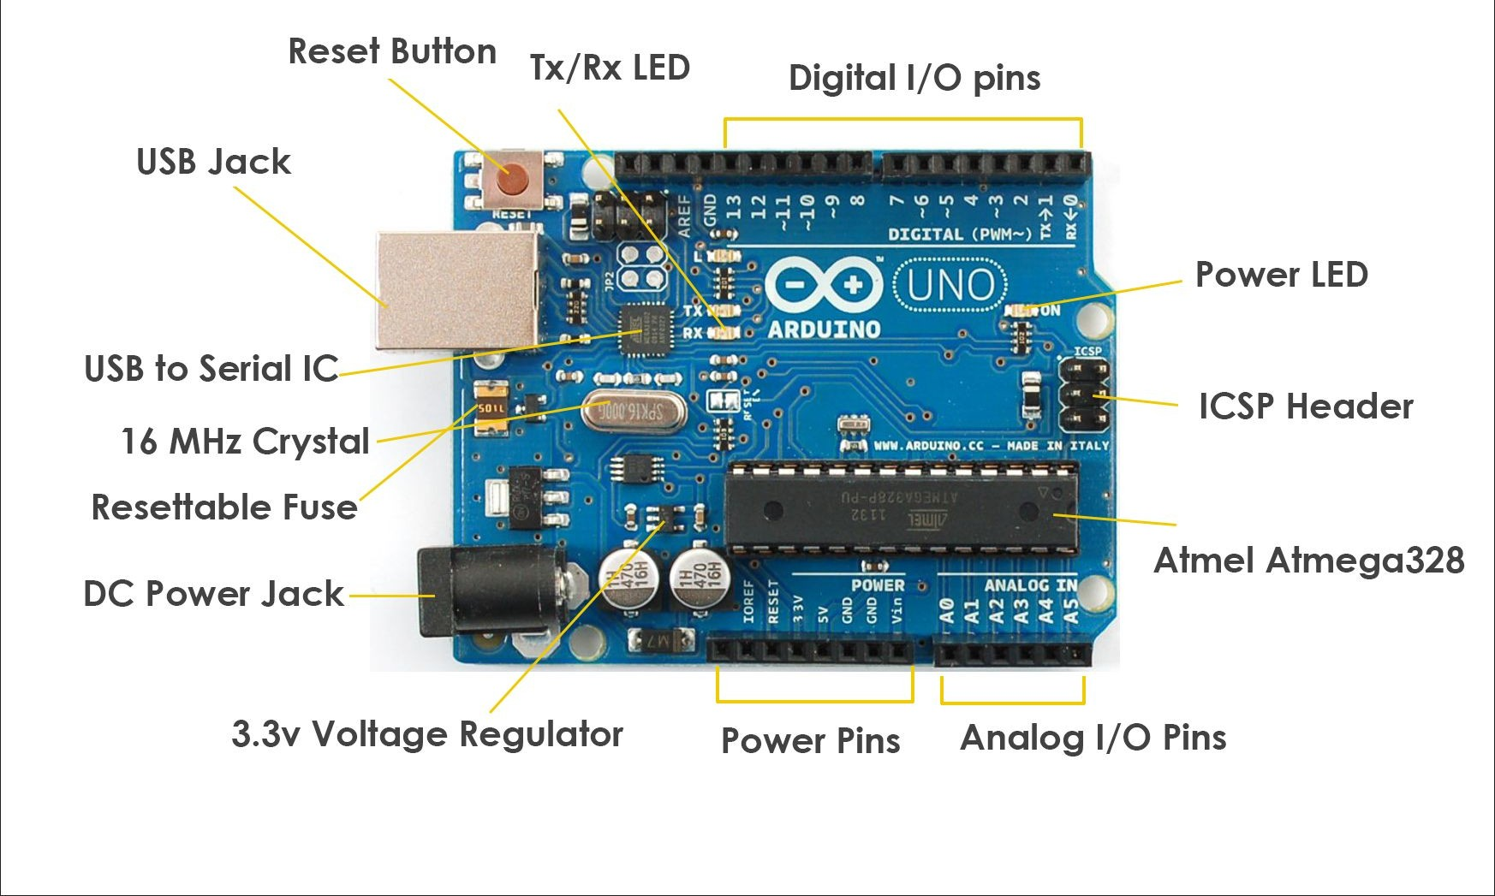
Input/Output Layout on Arduino

Slide 43
Digital & Analog I/O
Format
pinMode(pin, MODE);
The pinMode function requires two parameters. The pin parameter determines the digital interface number to set. The mode parameter determines whether the pin operates input or output mode. There are 3 values for interface mode setting:
INPUT - To set an interface for normal input mode OUTPUT - To set an interface for output mode
Getting a reading from an input device:
analogRead(pin)
Complete Example
void setup (){
Serial.begin(9600); pinMode(A1, INPUT);
}
void loop() {
float reading = analogRead(A1);
}

Slide 44
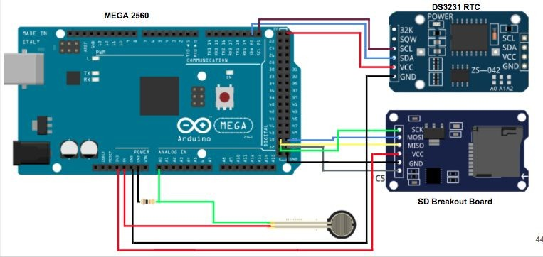
Reading Connection Diagrams

Slide 45
Writing to EEPROM
EEPROM is the long term memory in the Arduino. It keeps data stored even when powered off, like a USB flash drive. Important Note: EEPROM becomes unreliable after 100,000 writes
You’ll first need to include a library file in your sketch
#include <EEPROM.h>
#include <EEPROM.h>
void setup()
After you include the standard EEPROM library file, you can use the two standard EEPROM functions in your code:
{
for (int i = 0; i < 255; i++)
EEPROM.write(i, i);
}
read (address) - to read the data value stored at the EEPROM location specified by address
write (address, value) - to read values to the EEPROM location specified by address
void loop()
{
}

Slide 46
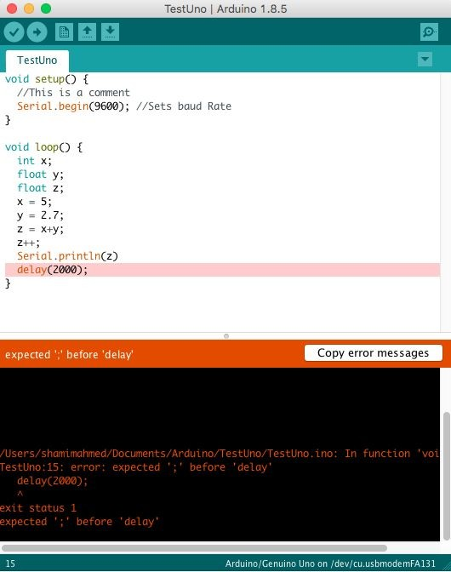
Debugging Applications
Compiler will give you the line code(s)
Compiler will give you the error
The line causing problems may get highlighted
Look up errors online

Slide 47
Agenda
Introduction to the Arduino Hardware
IDE, Variables, Operands, and the Serial Monitor Control Flow
Loops
Arrays & Strings
Functions, Structs, and Unions Libraries/IO/Connection Diagrams/EEPROM Combining it all together - Somewhat
Shameless Promotion

Slide 48
Let’s Combine everything together!
Mini Project: Testing the Humidity & Temperature in our breath
Materials: 1x Arduino Mega, 1x Humidity/Temp sensor
Required Knowledge: Using Libraries, Connection Diagrams, Loops, and Control flow
Sensor data sheet: https://www.mouser.com/datasheet/2/737/dht-932870.pdf
46

Slide 49
Agenda
Introduction to the Arduino Hardware
IDE, Variables, Operands, and the Serial Monitor Control Flow
Loops
Arrays & Strings
Functions, Structs, and Unions Libraries/IO/Connection Diagrams/EEPROM Combining it all together - Somewhat
Shameless Promotion

Slide 50
What is UC CubeCats?
Who are we?
UC CubeCats is UC’s premier Aerospace/Space tech student organization. We working on two main projects every year, one being our freshman/sophomore project & the other being our NASA-sponsored satellite that will be launching in 2 years!
Most of our work deals with microcontrollers, like Arduino, so a lot of programming is involved. If you are interested in joining, reach out to me at Nguye3np@mail.uc.edu.

Slide 51
Current Projects
Project Floppa
Every year, we do our year long fresh/soph project which usually involved sending a payload on a High Altitude Balloon, like the one’s China just sent & got shot down (Lmao).
This year’s fresh/soph project is called Project Floppa, which plans to do three amazing things.
Capture 360 degree footage as it ascends and descends
Capture water directly from a cloud using a peltier chip
Record the amount of air pollution in the area. (using Arduino, so a lot of programming!)
Leopard-SAT
For the last 3 years, we have been working on Leopard-SAT, which is our NASA sponsored CubeSat, which is scheduled to launch in 2 years. The goal of the satellite is to test different carbon-based materials to see which ones block out radiation the best. (can change how we build space crafts in the future)
Leopard-SAT Objectives:
Ensure the satellite can withstand the harsh environment of space
Design & manufacture our own circuit boards with sensors to detect radiation in space
Design a software system to gather the sensor data (vitals & rad) & relay it back to NASA/us

Slide 52
Questions about anything?
Have a question after the meeting? Talk to me here:
Insta: Nathan.p.ng
Linkedin: https://www.linkedin.com/in/nathanpng/
Email: Nguye3np@mail.uc.edu

